Slide 1


<Name>
<Date>

Slide 2

Outline
Executive Summary
Introduction
Methodology
Results
Conclusion
Appendix

Slide 3
Executive Summary
Summary of methodologies
Data Collection through API
Data Collection with Web Scraping
Data Wrangling
Exploratory Data Analysis with SQL
Exploratory Data Analysis with Data Visualization
Interactive Visual Analytics with Folium
Machine Learning Prediction
Summary of all results
Exploratory data analysis results
Interactive analytics demo in screenshots
Predictive analysis results

Slide 4
Introduction
Project background and context
Space X advertises Falcon 9 rocket launches on its website with a cost of 62 million dollars; other providers cost upward of 165 million dollars each, much of the savings is because Space X can reuse the first stage. Therefore, if we can determine if the first stage will land, we can determine the cost of a launch. This information can be used if an alternate company wants to bid against space X for a rocket launch. In this lab, you will create a machine learning pipeline to predict if the first stage will land given the data from the preceding labs.
Problems you want to find answers
What makes a good lauch site?
Predict if a launch will be successful or not
What features make a successful launch?

Slide 5

Section 1

Slide 6
Methodology
Executive Summary
Data collection methodology:
Collection using SpaceX API
Collection through webscrapping using Beautiful Soup
Perform data wrangling
Encoded categorical variables , cleaned missing values
Perform exploratory data analysis (EDA) using visualization and SQL
Perform interactive visual analytics using Folium and Plotly Dash
Perform predictive analysis using classification models
Used XGBoost model to make predictions

Slide 7
Data Collection
SpaceX API to CSV.
Data was collected using SpaceX API
To connect to the SpaceX API, we used the requests module in python.
We connected to the API and cleaned the data we needed.
After the data was cleaned we saved the data into a CSV file
Web scrapping using Beautiful Soup
Scraped table from Wikipedia.
We took the table data and saved it to a pandas dataframe
Once we cleaned the data we saved it to a CSV file.

Slide 8
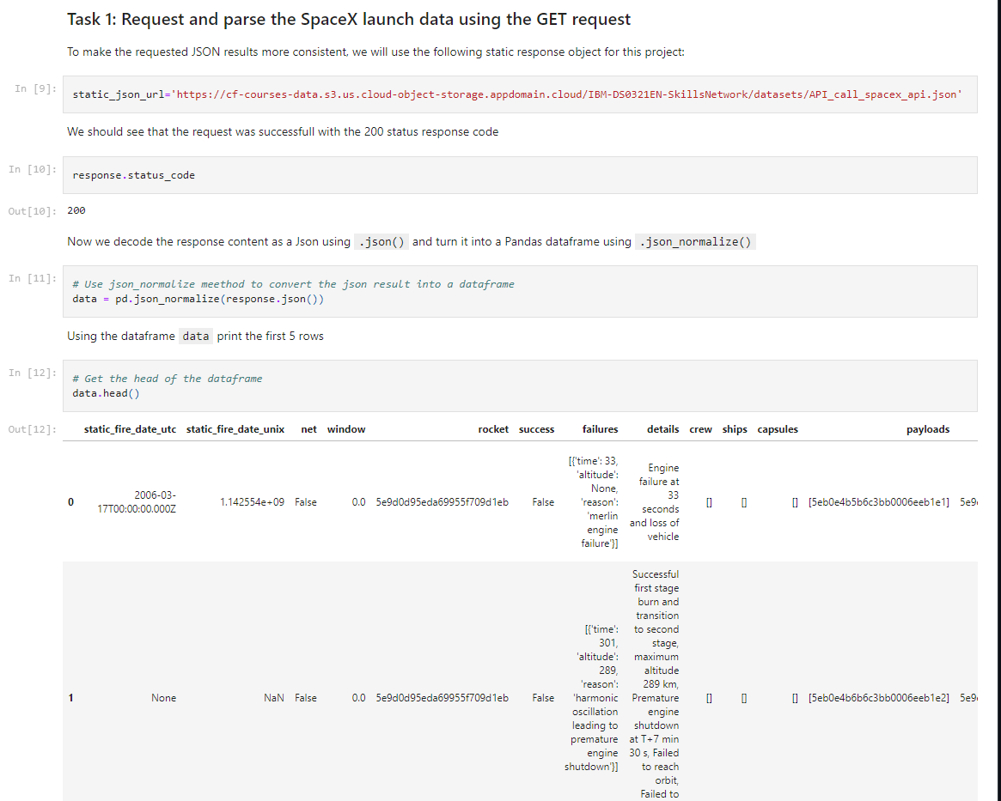
Data Collection – SpaceX API
We used the get requests module from python to connect to the SpaceX API. We also cleaned the data and eventually saved in to a CSV file.
Link to the notebook on GitHub: https://github.com/orbti/Coursera-Capstone/blob/main/jupyter-labs-spacex-data-collection-api.ipynb
Place your flowchart of SpaceX API calls here

Slide 9
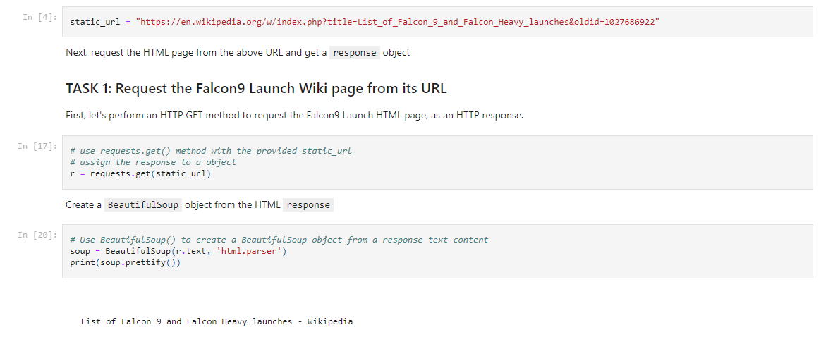
Data Collection - Scraping
Using Beautiful Soup, we scrapped the tables from Wikipedia.
We then parsed the information into a pandas dataframe to save as a CSV
Link to the note book on GitHub: https://github.com/orbti/Coursera-Capstone/blob/main/jupyter-labs-webscraping.ipynb

Slide 10
Data Wrangling
We used categorical encoding.
We cleaned out all the columns we will not use.
We filled in missing data.
Link to the notebook on GitHub: https://github.com/orbti/Coursera-Capstone/blob/main/labs-jupyter-spacex-Data%20wrangling.ipynb

Slide 11
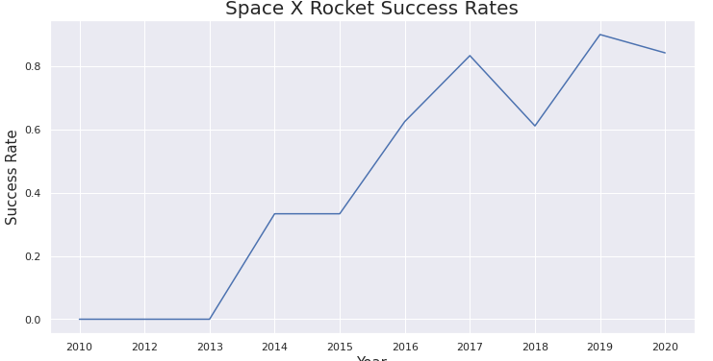
EDA with Data Visualization
We explored the data to look at the success rates for each year of launches.
https://github.com/farishelmi17/Applied-Data-Science-Capstone-SpaceX/blob/main/notebook:Exploratory_Data_Analysis_with_Visualisation_Lab_jJkKVG6F1.ipynb

Slide 12
EDA with SQL
We loaded the SpaceX data into a sqlite database.
Items we looked at in SQL:
Names of unique launch sites
Total payload mass carried by boosters launched by NASA (CRS)
Average payload mass carried by booster version F9 v1.1
Rank the count of successful landing outcomes between the date 04-06-2010 and 20-03-2017 in descending order.
Link to notebook on GitHub: https://github.com/farishelmi17/Applied-Data-Science-Capstone-SpaceX/blob/main/notebook:Exploratory_Data_Analysis_with_SQL__eqznon1EA.ipynb

Slide 13
Build an Interactive Map with Folium
Marked all launch sites on a mpa.
Mark the success/failed launches for each site on the map.
Calculate the distance between a launch site to its proximities.
Link to notebook on GitHub: https://github.com/orbti/Coursera-Capstone/blob/main/lab_jupyter_launch_site_location.ipynb

Slide 14
Build a Dashboard with Plotly Dash
We created a interactive dashboard with Plotly and Dash
We plotted a pie chart showing the total launches by a site.
We plotted a scatter plot of the relationship between class and payload size in mass (kg).
Explain why you added those plots and interactions
Link to notebook on GitHub: https://github.com/orbti/Coursera-Capstone/blob/main/dash/spacex_dash_app.py

Slide 15
Predictive Analysis (Classification)
I loaded in our data using pandas. Then split the data into a train and test dataset.
I used a Pipeline to standardize and impute the data.
I used GridSearchCV to select the best hyperparameters for the model I was looking at.
Link to notebook on GitHub: https://github.com/orbti/Coursera-Capstone/blob/main/SpaceX_Machine%20Learning%20Prediction_Part_5.ipynb

Slide 16
Results
Exploratory data analysis results
Interactive analytics demo in screenshots
Predictive analysis results

Slide 17

Section 2

Slide 18
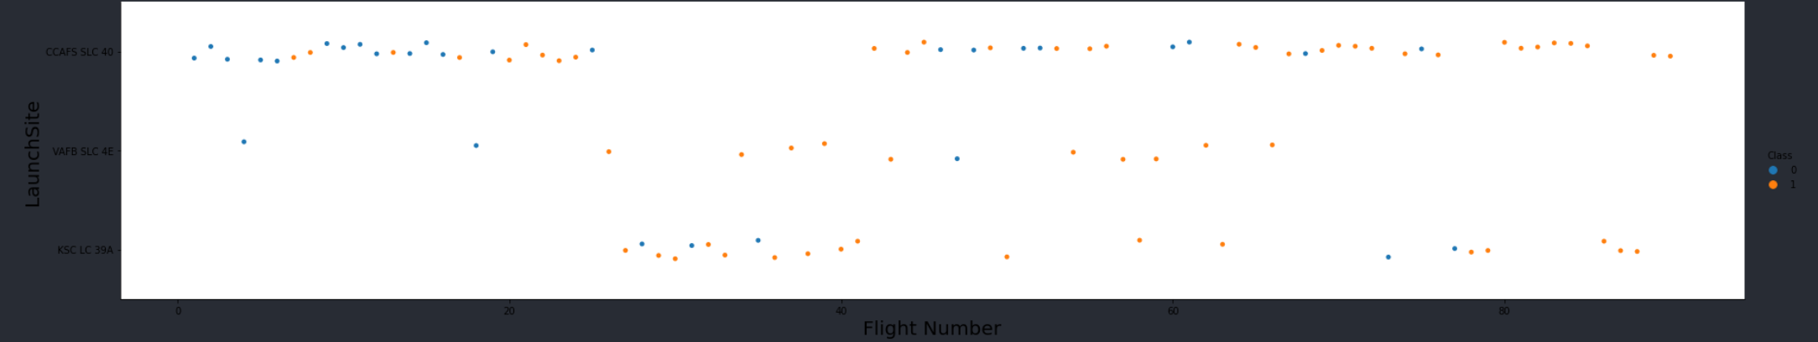
Flight Number vs. Launch Site
The sites with a greater number of flights have more successful launches.

Slide 19
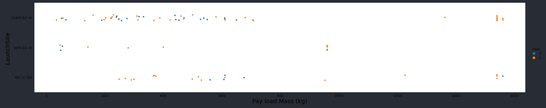
Payload vs. Launch Site
Larger the payload the more successful the launch.

Slide 20
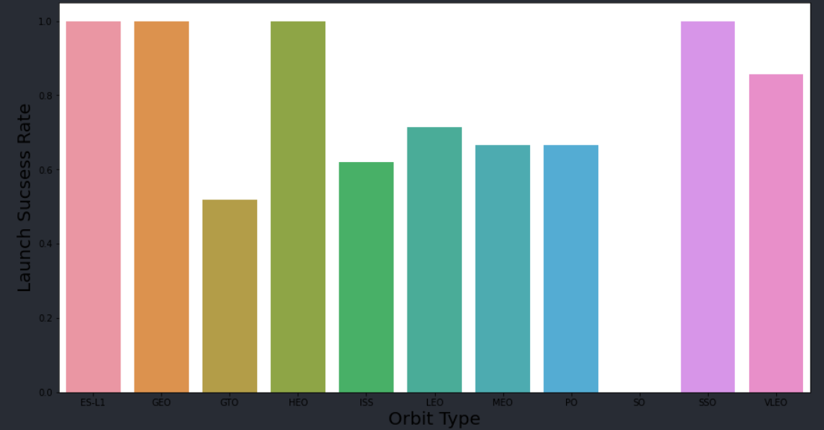
Success Rate vs. Orbit Type
Launch with orbit type ES-L1, GEO, HEO AND SSO had the most successful launches.

Slide 21
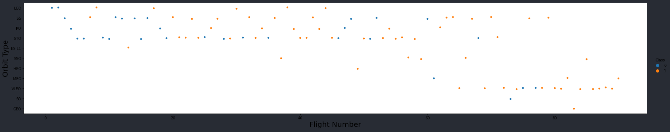
Flight Number vs. Orbit Type
You should see that in the LEO orbit the Success appears related to the number of flights; on the other hand, there seems to be no relationship between flight number when in GTO orbit.

Slide 22
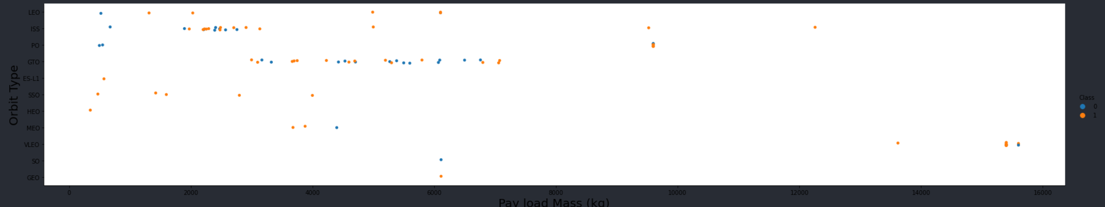
Payload vs. Orbit Type
With heavy payloads the successful landing or positive landing rate are more for Polar, LEO and ISS.
However, for GTO we cannot distinguish this well as both positive landing rate and negative landing(unsuccessful mission) are both there here.

Slide 23
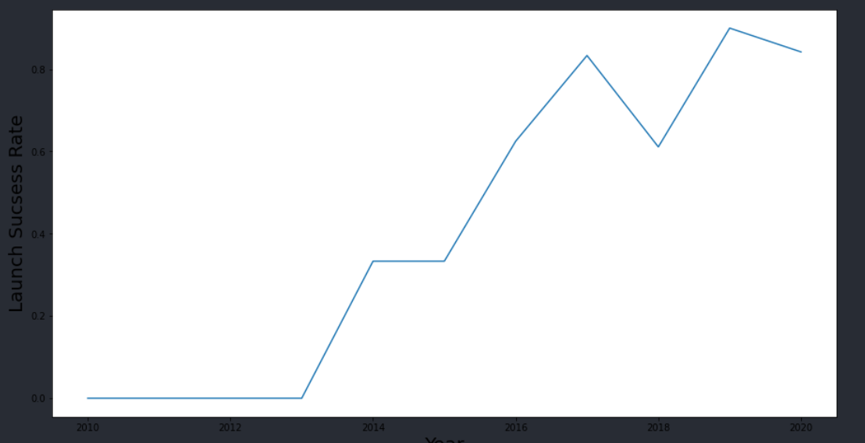
Launch Success Yearly Trend
you can observe that the success rate since 2013 kept increasing till 2020

Slide 24
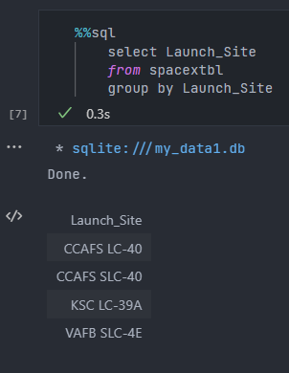
All Launch Site Names
We selected all the launch sites and grouped them.

Slide 25
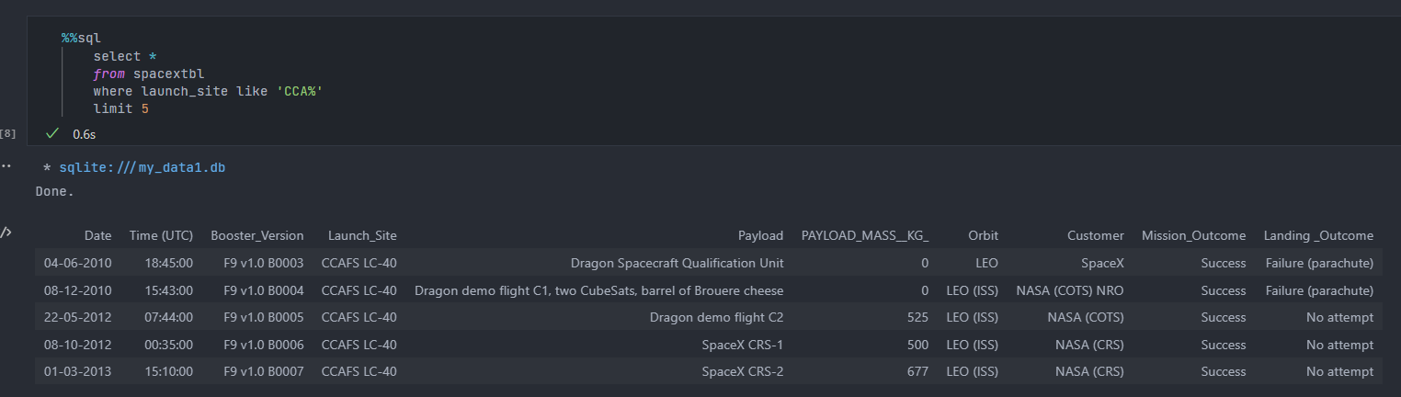
Launch Site Names Begin with 'CCA'
Selected all columns where launch site contains CCA at the start and limited it to 5 results.

Slide 26
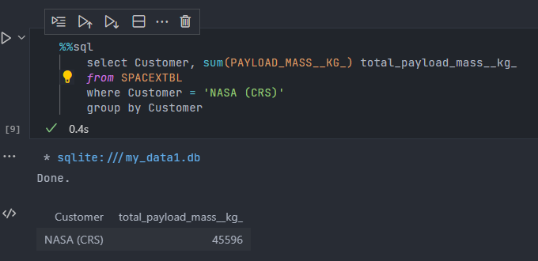
Total Payload Mass
Selected customer and sum of payload mass.
Filtered results to only included customers from ‘NASA (CRS)’ when grouped by customer.

Slide 27
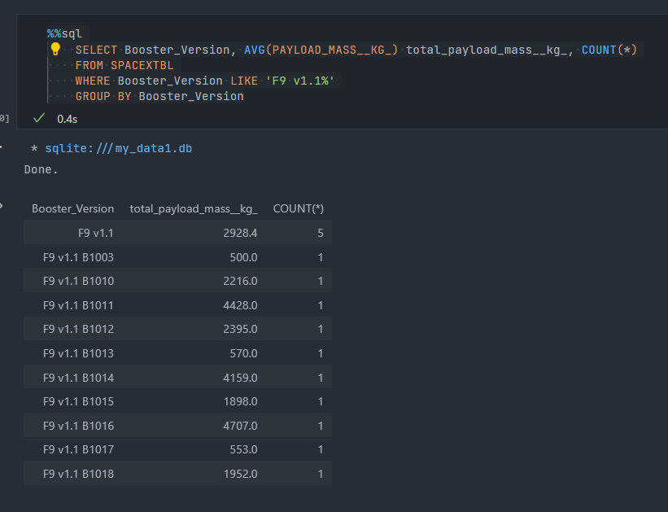
Average Payload Mass by F9 v1.1
Selected the average payload of each booster with version ‘F9 v1.1’

Slide 28
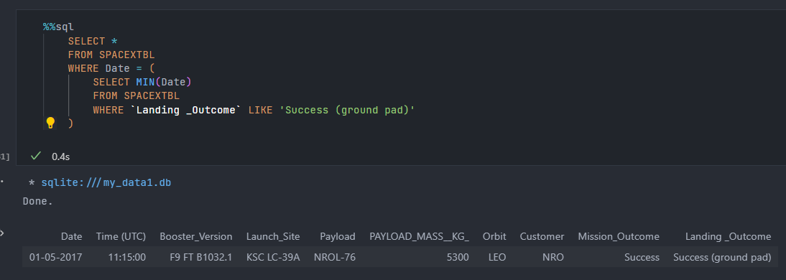
First Successful Ground Landing Date
January 05, 2017 was the first successful launch date.

Slide 29
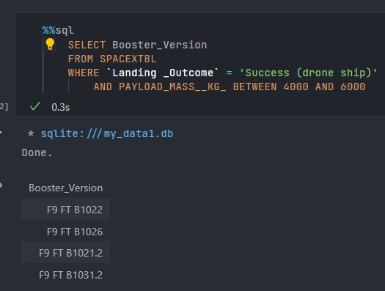
Successful Drone Ship Landing with Payload between 4000 and 6000
We filtered using where and between.

Slide 30
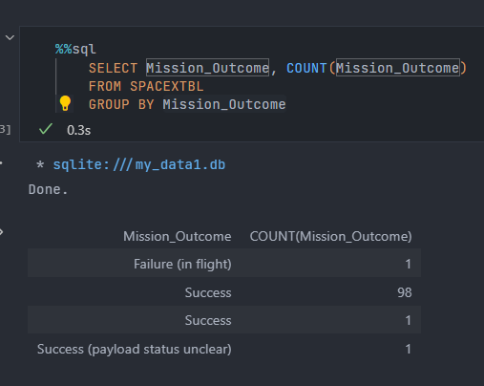
Total Number of Successful and Failure Mission Outcomes
Counted all rows that are grouped by mission outcome.

Slide 31
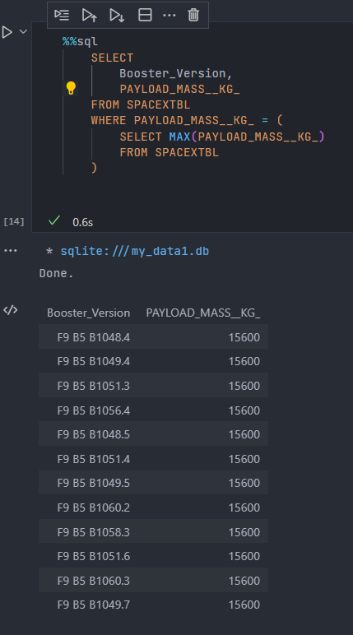
Boosters Carried Maximum Payload
Used a subquery to filter each booster versions max payload.

Slide 32
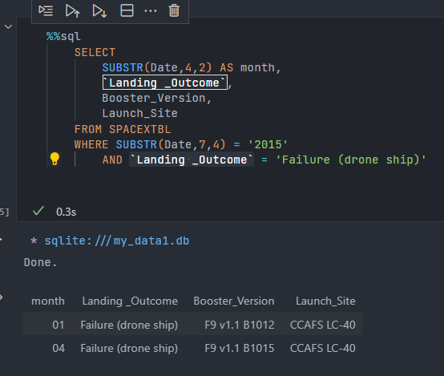
2015 Launch Records
List the failed landing_outcomes in drone ship, their booster versions, and launch site names for in year 2015
We used a substr function to filter all years to 2015 and landing outcome is failure with a d.rone

Slide 33
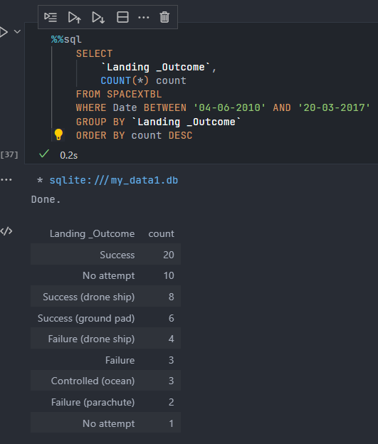
Rank Landing Outcomes Between 2010-06-04 and 2017-03-20
Rank the count of landing outcomes (such as Failure (drone ship) or Success (ground pad)) between the date 2010-06-04 and 2017-03-20, in descending order

Slide 34

Section 3

Slide 35
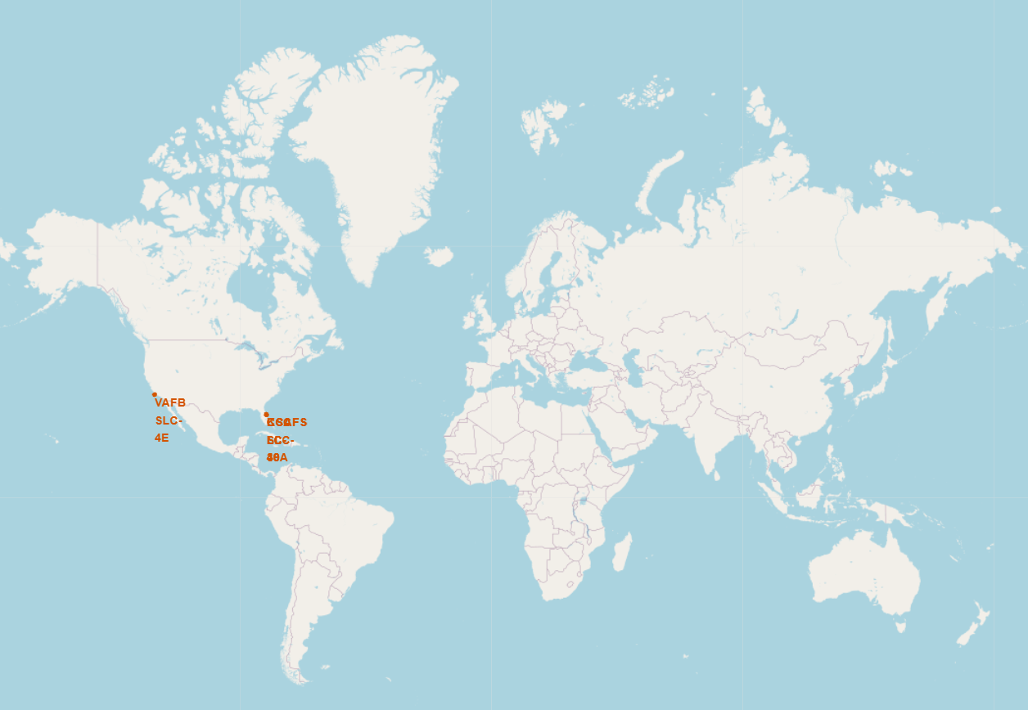
All Launch sites Globally
All launch sites are located in the United States.

Slide 36
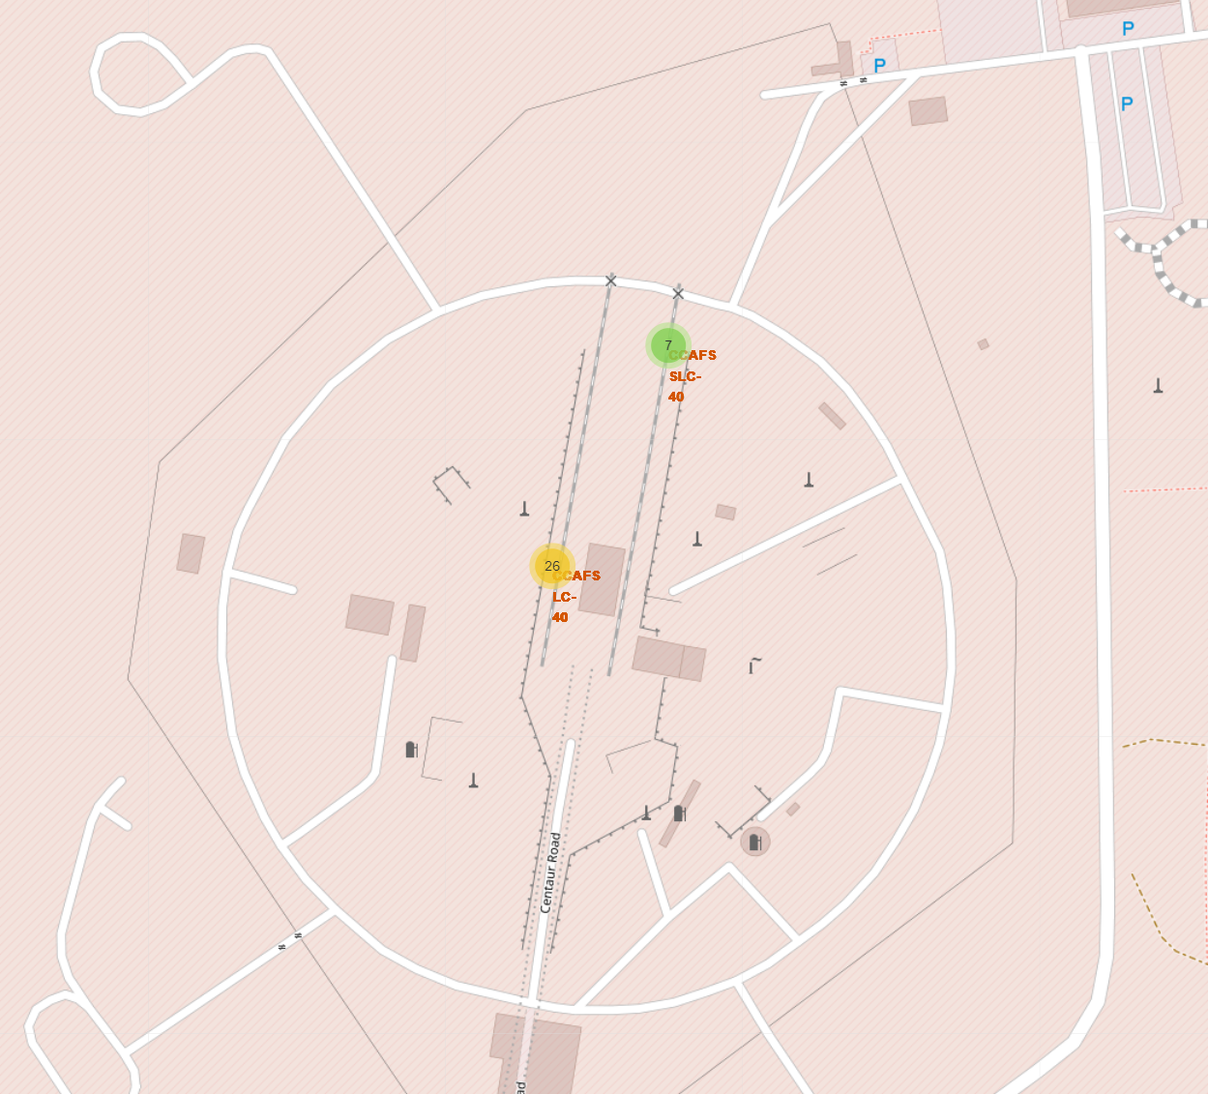
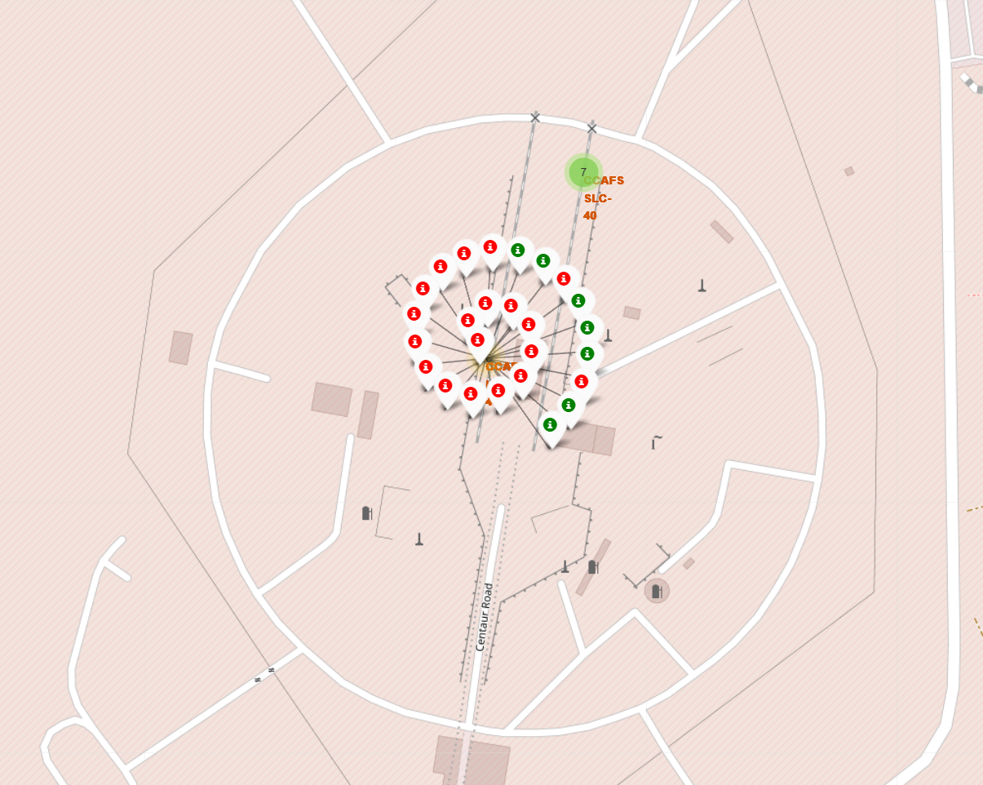
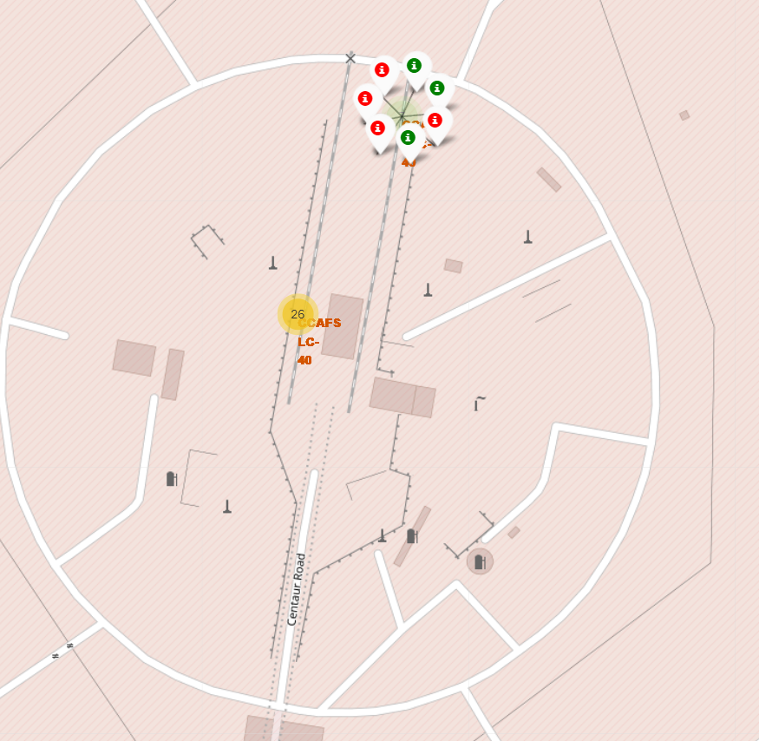
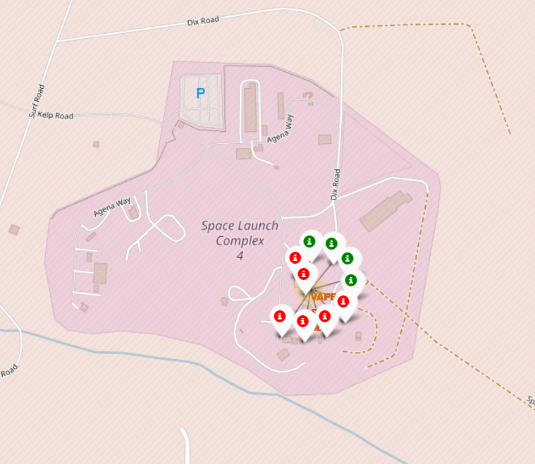
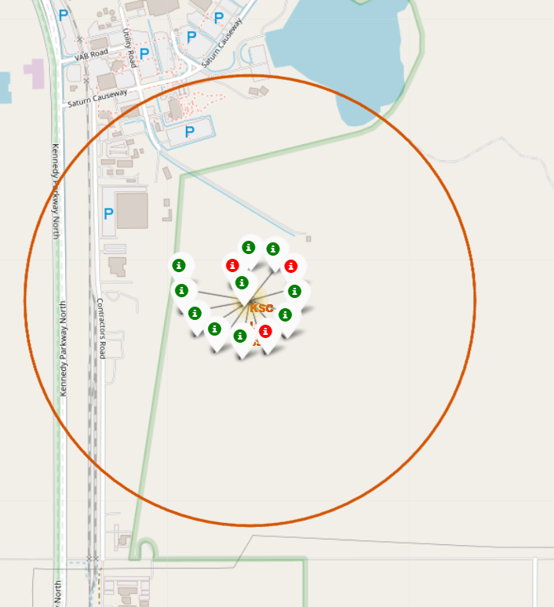
Successful/Failed Markers for Launch Sites
Florida and California sites
Red means failed launches
Green means successful launches

Slide 37
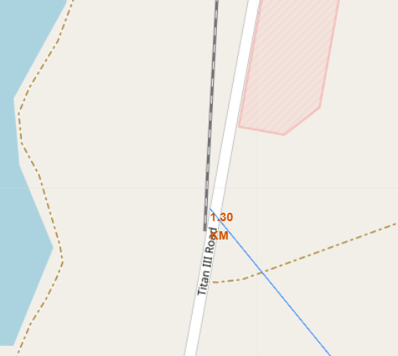
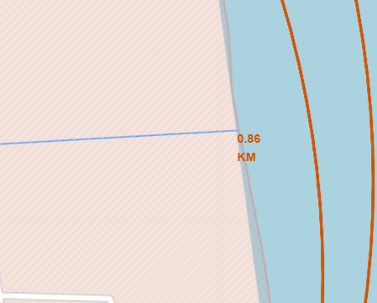
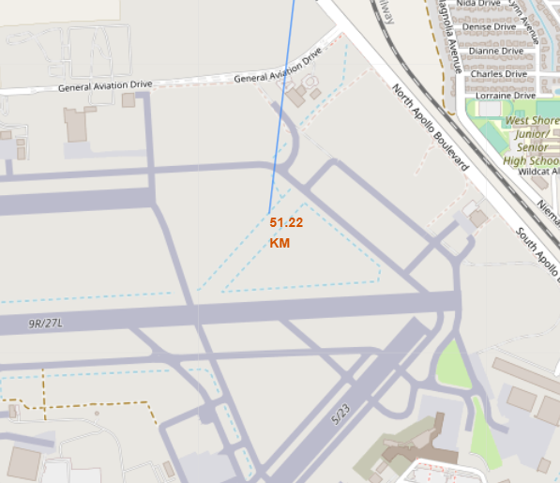
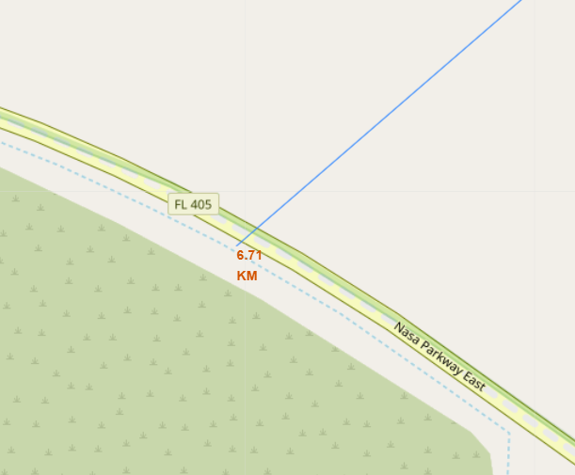
Launch Sites Distance to Landmarks
Are launch sites near railways? No
Are launch sites near highways? No
Are launch sites near coastline? Yes
Do launch sites keep certain distance away from cities? Yes

Slide 38

Section 4

Slide 39
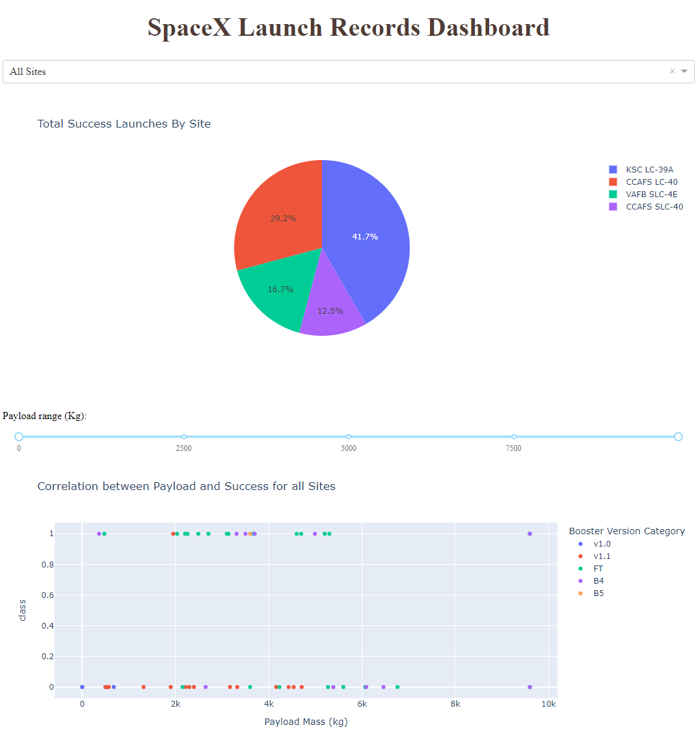
Dashboard showing all sites
Most successful launch site is KSC LC-39A

Slide 40
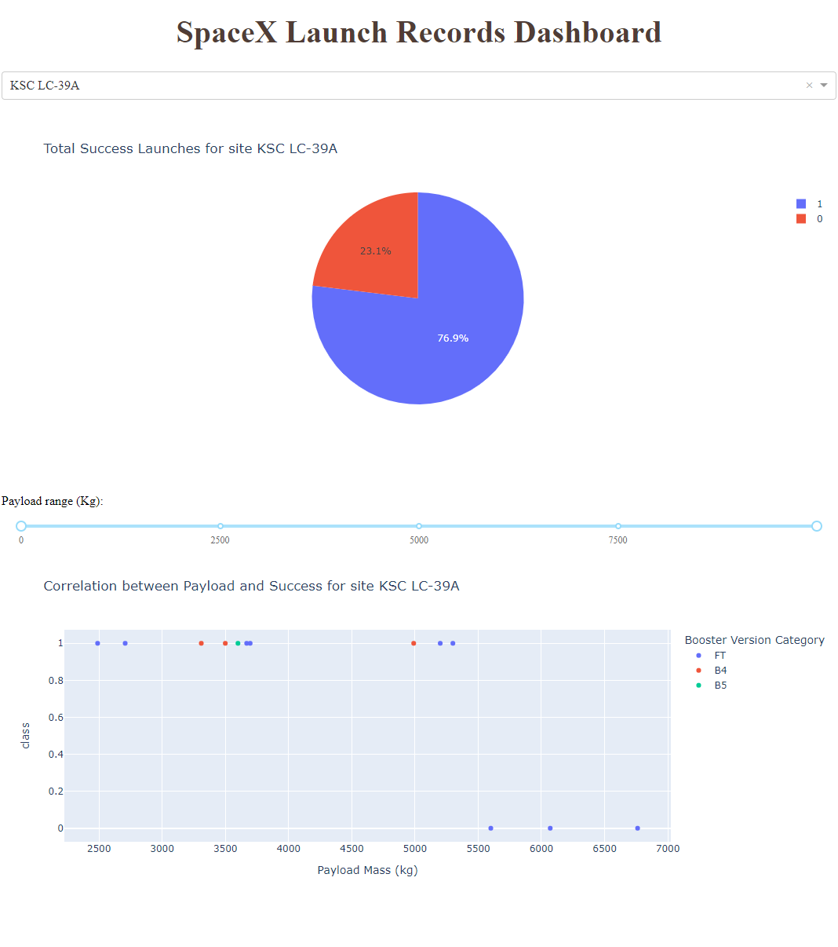
Dashboard showing site KSC LC-39A
Heavy payloads did not do well in this site.

Slide 41

Dashboard with payload set to 2500-5000
With payloads between 2500 and 5000, booster version FT and B4 were very successful.

Slide 42

Section 5

Slide 43
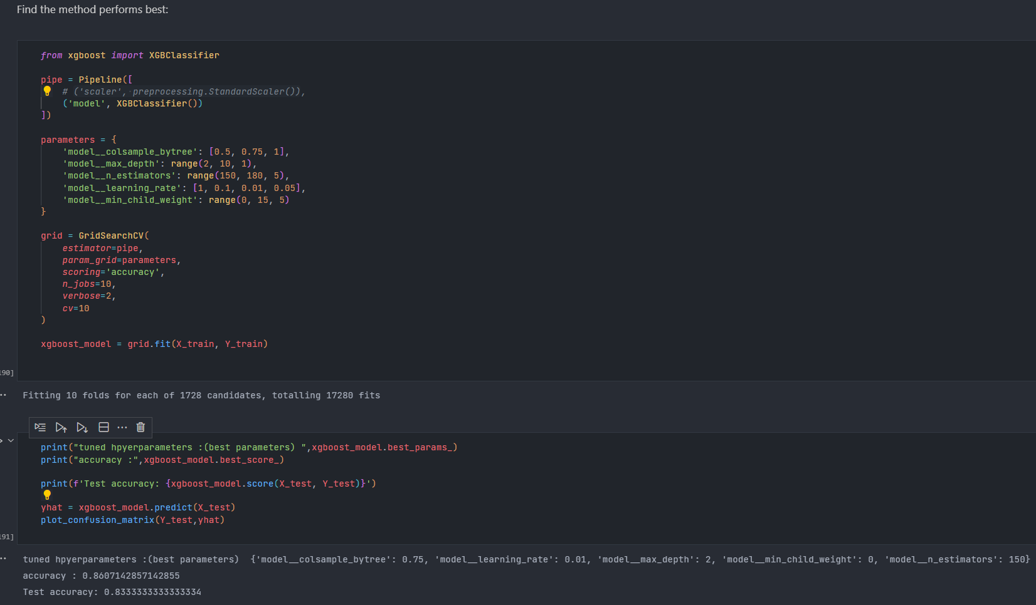
Classification Accuracy
XGBoost had the best accuracy with 83% on the test data.

Slide 44
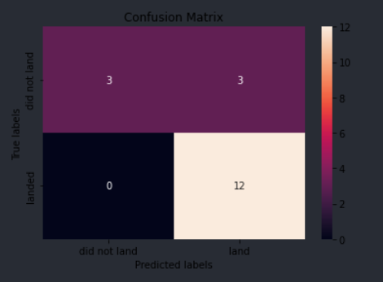
Confusion Matrix
The confusion matrix for XGBoost shows that the model is good at predicting successful landings. It still needs to be optimized to predict failed landings.

Slide 45
Conclusions
Larger the payload the more successful the launch site is
Launch success rate started to increase after year 2013 and is still trending up.
XGBoost was the best model to predict launch success.

Slide 46


